Slide 1
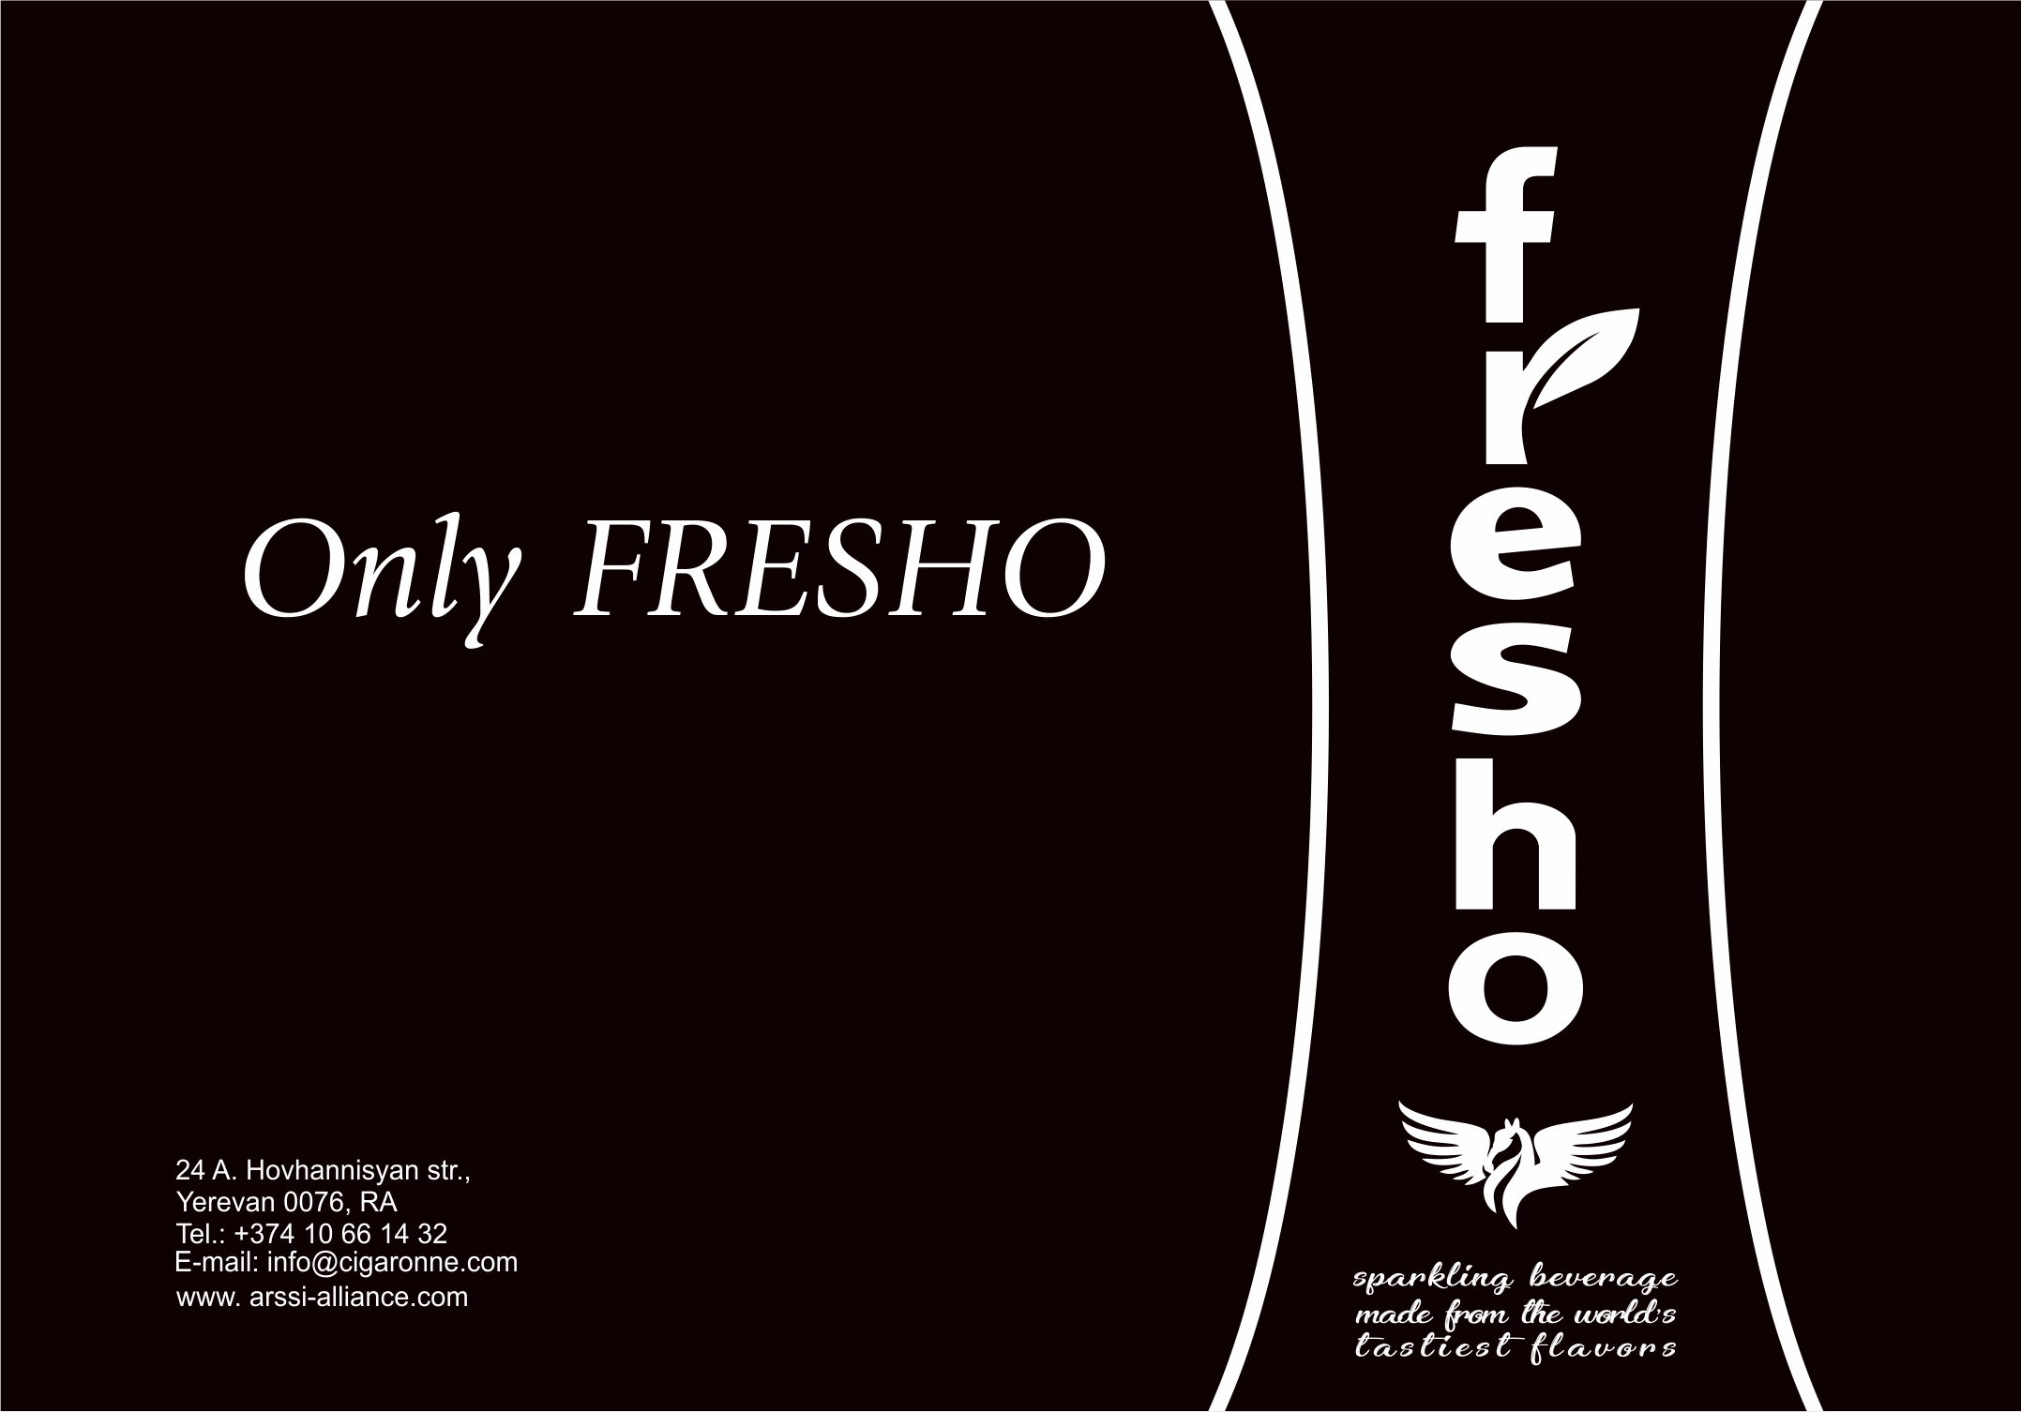
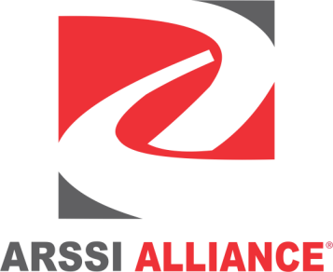

Slide 2
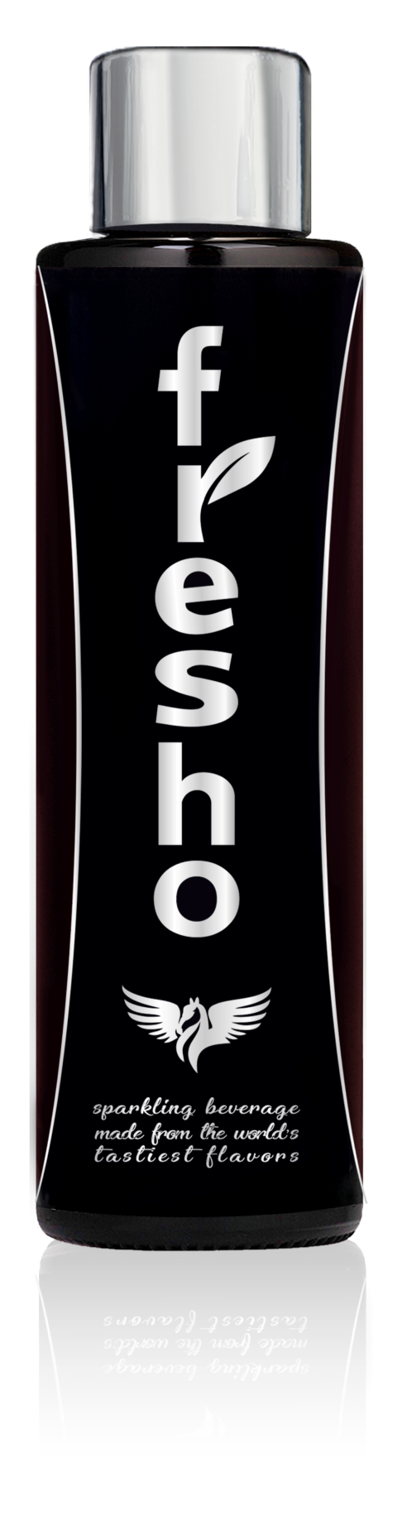

Summer with FRESHO – the beginning of a new season.
We’re excited to announce the launch of FRESHO, a new sparkling beverage that’s unlike anything you’ve ever tasted before.
With its lush bouquet of pomegranate, lemon and herbs, FRESHO has a sweetness that is just on the right side of tart, creating a distinctly unique, fresh taste experience with every sip.

Slide 3
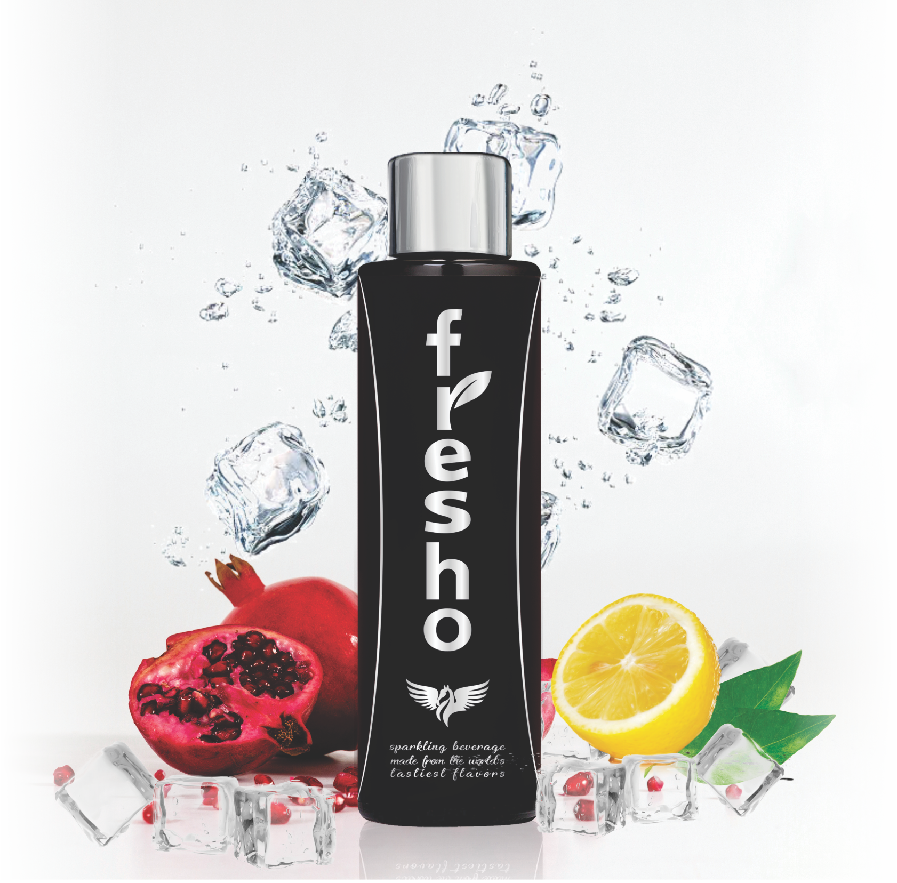
FRESHO’s secret is in its perfectly balanced recipe made with natural, mineral-rich ingredients.
It is a masterfully crafted blend of cold pressed pomegranate and lemon juices, locally grown sun-kissed fruit and pure, mountain spring water from the Armenian Plateau.

Slide 4
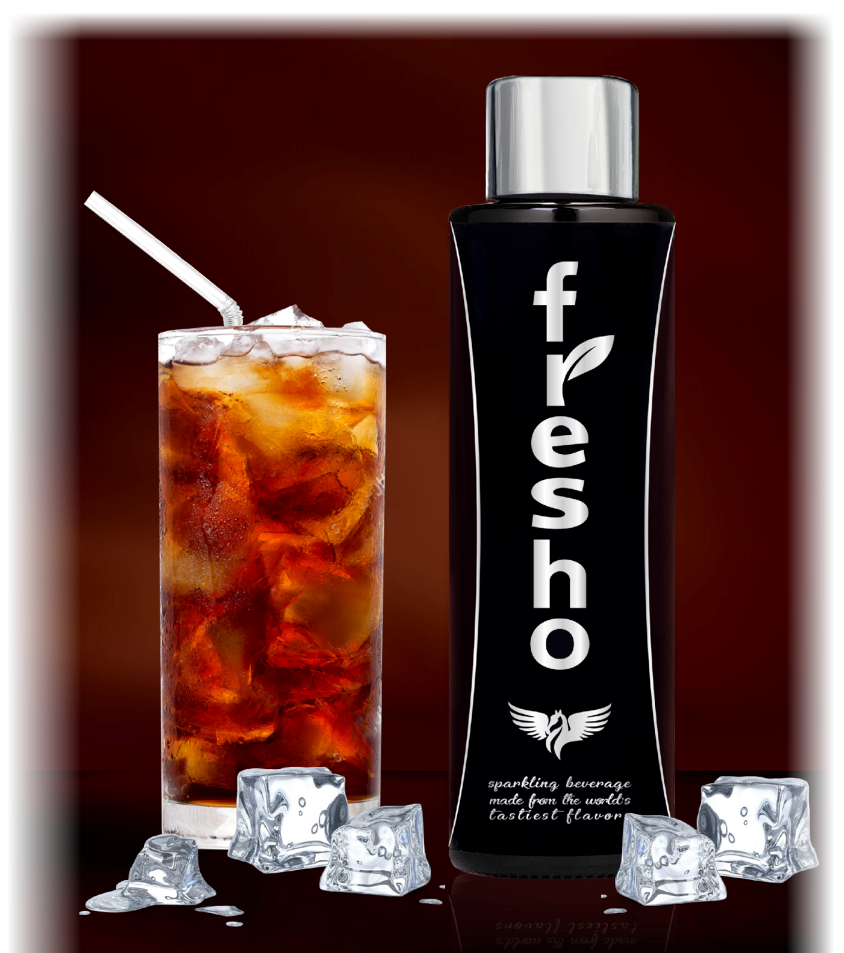
An extra cold bottle of delicious FRESHO is the excellent choice to quench your thirst and keep you hydrated all season long.
Its dark brown and silver hues add to the innovative and sophisticated packaging design, giving the brand an elegant, high-end feel.

Slide 5
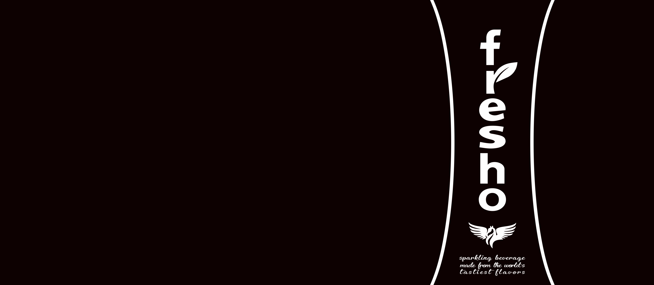
FRESHO is bottled in imported, 230ml dark amber glass bottles designed with metallic foil labels and combined twist-off crown caps, as well as 300ml aluminum cans with lithographic design and printing.
The beverage is available in durable, 24 pack corrugated boxes that include its storage and transportation details.

Slide 6

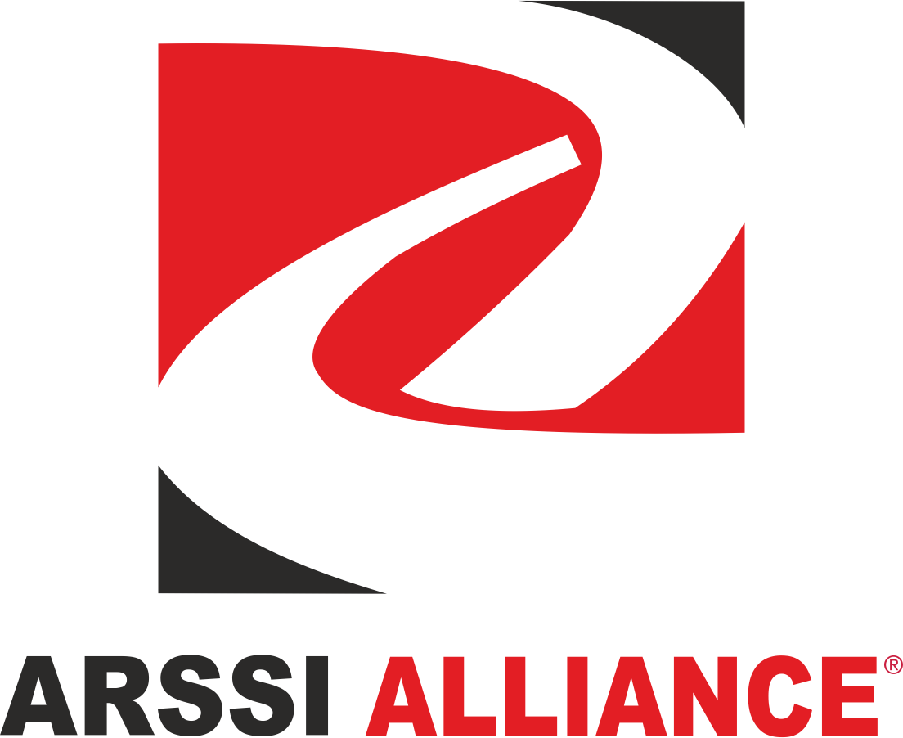
24 A. Hovhannisyan str.,
Yerevan 0076, RA
Tel.: +374 10 66 14 32
E-mail: info@cigaronne.com
www. arssi-alliance.com

